Slide 1
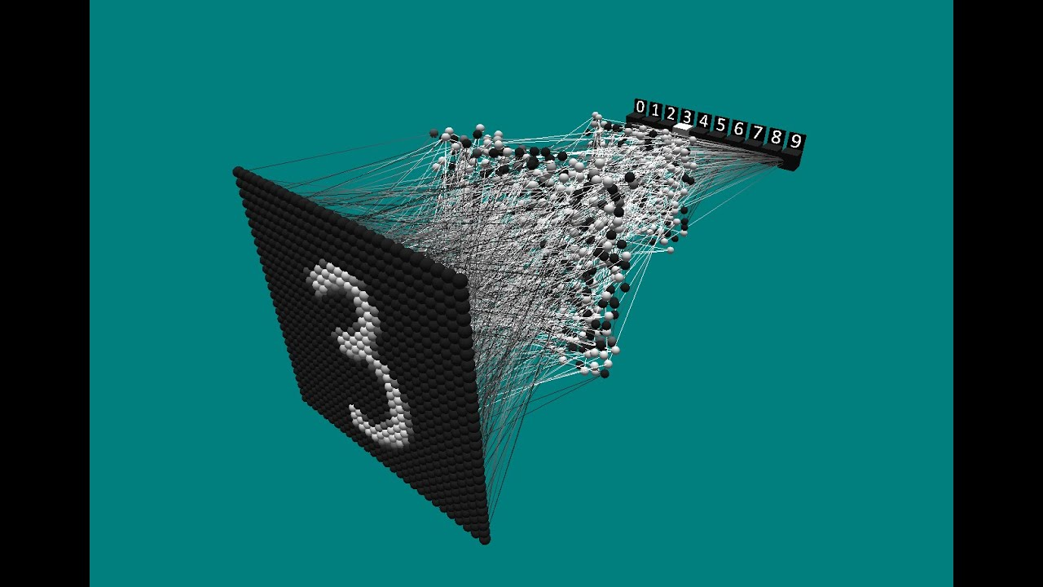
Neural network character recognition system
Dario Aliberti
Tommaso Tonarini
Notes:
1

Slide 2
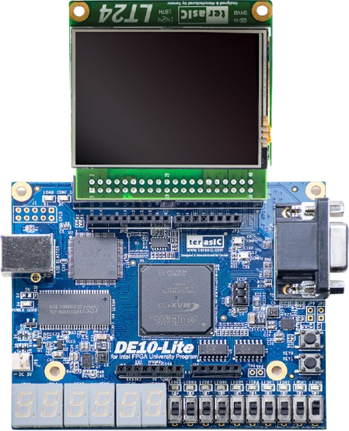
Hardware modules
LT24 terasIC display module
DE10-lite dev. board

Slide 3
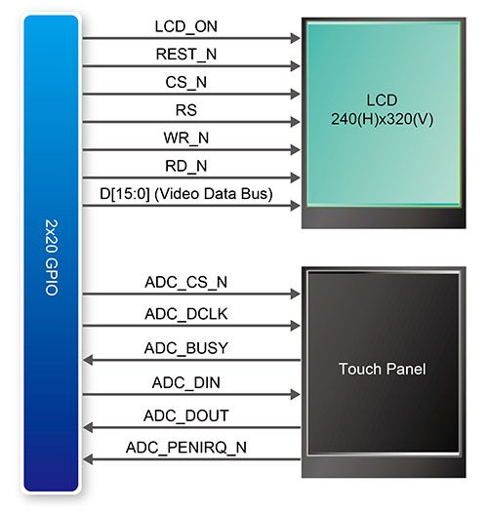
LT24 communication bus
Touch panel
It is used SPI interface to retrieve data from the AD7843 ADC inside the module
LCD
It is used parallel bus interface to display images

Slide 4
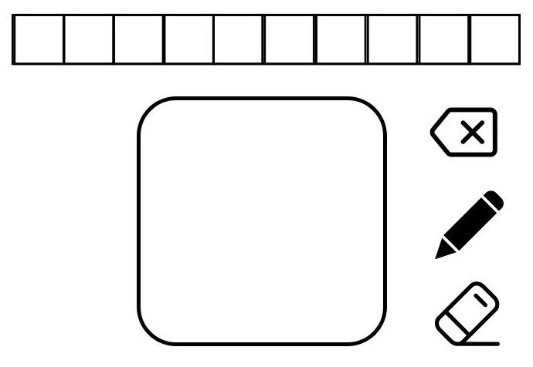
GUI implementation
Erase character
Letter-boxes
Draw
Drawing area
Erase all characters

Slide 5
CPU hardware modules
Clock distribution modules (source clock, pll, etc.)
PIO modules (switch, buttons, etc.)
CPU module
External SDRAM
LT24 modules
Floating-point op.
Other modules
NiosII fast
SDRAM controller
PIO parallel communication with LCD module
SPI interface communication with touch screen module
Floating point hardware arithmetic
Notes:
5

Slide 6

EMNIST dataset confront
Character drawn on the screen
Character from EMNIST dataset
Data written in a 28x28 grayscale matrix (become 784 flattened array)
The EMNIST character is slightly bigger than the other

Slide 7
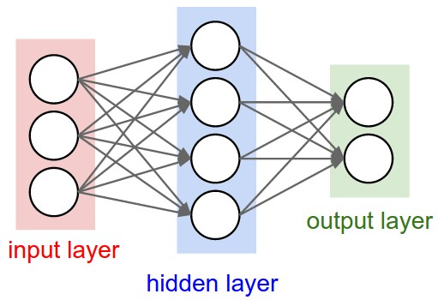
Neural Network
784 inputs:
Are the element of the letter matrix
1024 input layer neurons
1024 inputs:
Are the outputs of the input layer
512 hidden layer neurons
512 inputs:
Are the outputs of the hidden layer
62 output layer neurons

Slide 8
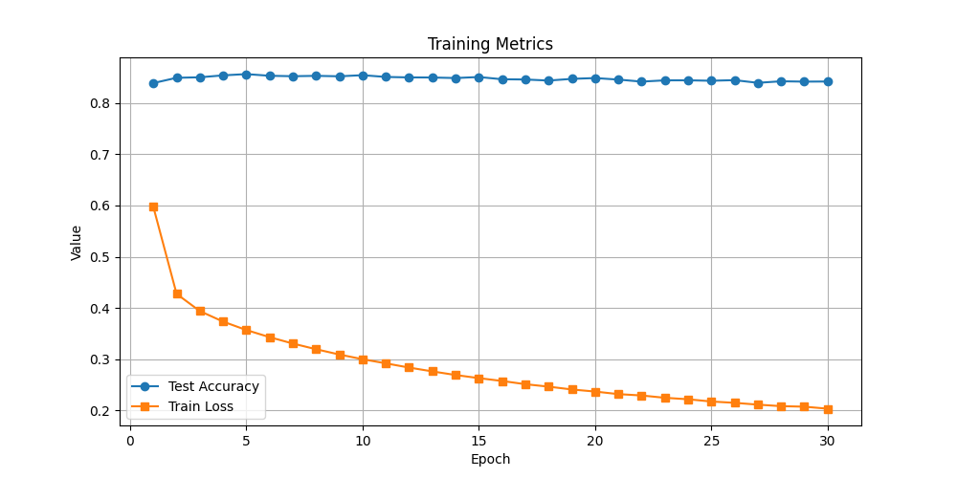
Training graph

Slide 9
Thank you
Dario Aliberti
Tommaso Tonarini
Notes:
9

